Slide 1
Cell-Cell Interaction (Communication)

Slide 2
Background
1. multicellular organisms had to acquire various modes of cell-to-cell (intercellular) communication to develop and then control their coordinate functioning
2. Embryonic development where the cells differentiation and ultimate fate are controlled by communication with neighbouring cells. In the developed organism, intercellular communication coordinates the activities of multiple cell types required for complex organismal processes such as immune response, growth and homeostasis(体内平衡). Defects in cell-to-cell communication, including dysregulation of autocrine（自分泌） signalling, are also medically important in cancer, autoimmune and metabolic diseases
3. Cell-to-cell communication across multiple cell types and tissues strictly governs proper functioning of metazoans and extensively relies on interactions between secreted ligands and cell-surface receptors.
4. Cell–cell interactions through signal-transduction pathways are crucial in the coordination of embryonic development. Typically, signalling pathways are activated by the binding of a ligand to a transmembrane（跨膜） receptor, which in turn leads to the modification of cytoplasmic（细胞质） transducers. Subsequently, these transducers activate transcription factors that ultimately alter gene expression. One of the most surprising findings about signalling processes is that only a few pathways are involved in and are responsible for most of animal development
5. The numerous cell types present in multicellular organisms interact and cooperate during embryonic（胚胎） development and adult life, forming a dynamic cellular network. Cellular functions are often lost or perturbed when neighboring cells are absent or malfunctioning. Examples of cellular interactions that lead to specific functions include plasma cell–eosinophil（嗜酸性粒细胞）and erythroblast（成红血细胞）–macrophage (erythroblastic island) interactions, as well as the hematopoietic stem cell niche in bone marrow (BM)

Slide 3
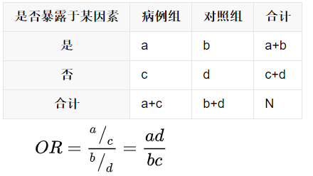
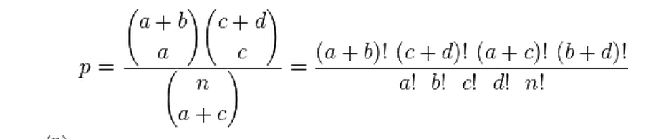
Methods
1. collect information
(1) known interacting ligand–receptor pairs
(2) public protein–protein interaction (PPI) information
(3) manually dissect interacting structures in experiments including dublets or triplets
2. assign cell types based on the scRNA-seq data
3. identity marker genes (optinal)
4. characterize cell-cell communication including
cell type specific cell-cell communication
B cell-monocyte and B cell-T cell interactions
Fisher's exact test

Slide 4
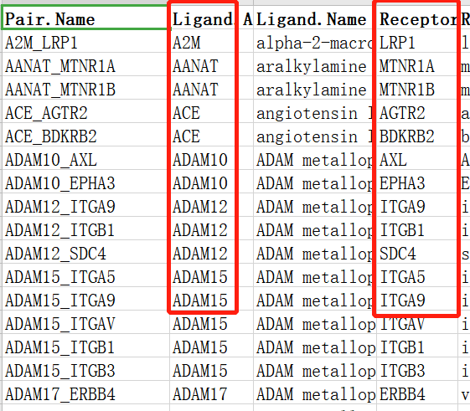
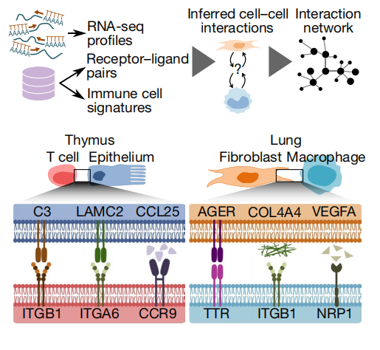

1. Ligand-Receptor pairs
assign cell types
perform pairwise differential expression analysis
identify the interactive ligand-receptor pairs both expressed in compared cell types
identify significant genes for each organ/tissue/cell type that were upregulated in the cell type compared to other groups
choose marker genes for each organ/tissue/cell type that were upregulated in comparison to other organs
scored a given ligand-receptor interaction between cell type A and cell type B
quantify the enrichment of known receptor–ligand pairs among the identified marker genes
the product of the average expression levels of the ligand in one cell type and the corresponding receptor in the other cell type.
calculate the fraction of these gene pairs that were annotated as receptor–ligand pairs among all pairs of marker genes between cell type A and cell type B
identify significant interactions by one-sided Wilcoxon rank-sum
test and Benjamini-Hochberg multiple hypothesis correction
identify significant interactions by Fisher's exact test among all the cell type pairs (between tissue A and tissue B)

Slide 5
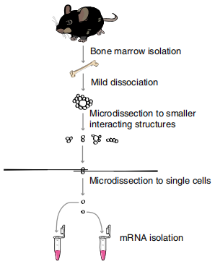
2. structual interaction pairs by experiments (ProximID)
doublet, triplet (three different cells interacting with each other), central connector (n cells interacting with one common cell), and in-line (n cells interacting in successive order).
use single-molecule fluorescence in situ hybridization（单分子荧光原味杂交）to manually dissect small interacting BM (骨髓) structures
727 small interacting BM structures for a total of 1,728 cells across 18 independent experiments
infer the cell types by RaceID2 algorithm
method 1
method 2
method 3
method 4
70% of the cells for training, and 30% of the cells for testing
create doublets or triplets with all possible combinations of cell types, with 100 random cells sampled for each class of doublets and 10 cells for each class of triplets
train random forest classifiers to recognize virtual structures of doublets or triplets for all combinations of cell types by transcript counts normalized for all structures using top ten variable genes
create 100 examples for each possible combination of doublets or triplets
The classes were defined based on the presence or absence of a particular cell type in the virtual structure
train 20 random forest classifiers (one per cell type) to recognize whether a particular cell type was present in a virtual structure (doublets or triblets)
randomly distribute the single cells into three parts
use a second layer of random forests to integrate the probabilities of the different cell-type-specific random forests
use one for the training. This first test set was used to train random forests to assign classes of doublets or triplets on the basis of the probabilities given by the individual random forest models. The third set was used to test the two layers of random forests.
used a Monte Carlo simulation approach and ramdomly chose a starting set of doublets or triplets respectively summed.
calculate the Spearman correlation to the test structure
iteratively (10,000 times) replaced one of the cells from the training structure in order to reach a higher correlation

Slide 6
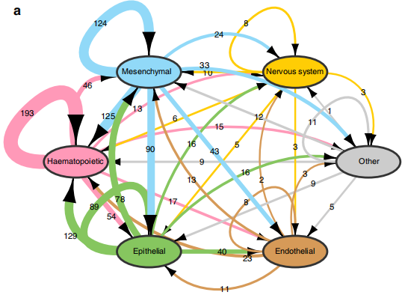
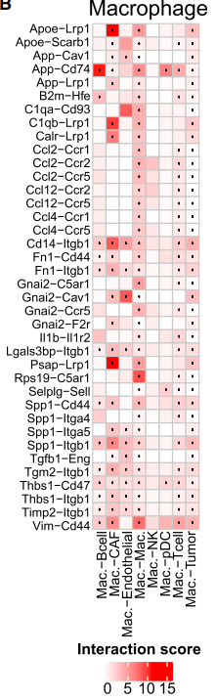
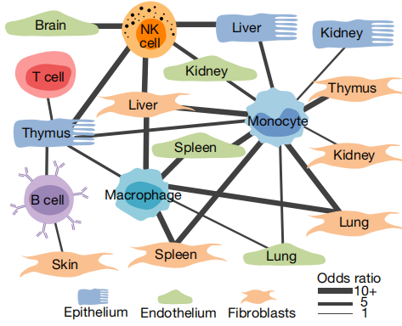
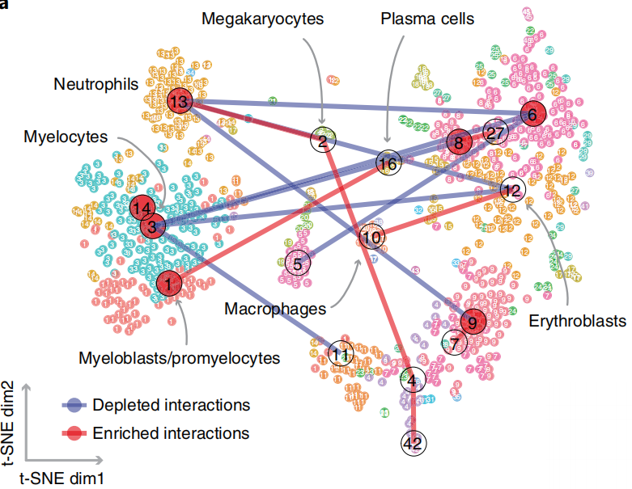
create a statistical distribution of chance interactions under the null hypothesis and keeps the original data structure
detect interactions that were significantly (P<0.05) enriched or depleted
compared with numbers in the background model
the number of pairs between broadcasting and target cell
These various cell types all communicate via ligand-receptor interactions, where the ligand can either be secreted and bind to the receptor in soluble form or be membrane-bound and require physical proximity of the two interacting cell types. Furthermore, communication between these different cell types is implicated in mechanisms for tumorigenesis, tumor progression, therapy resistance, immune infiltration, and inflammation.

